Slide 1
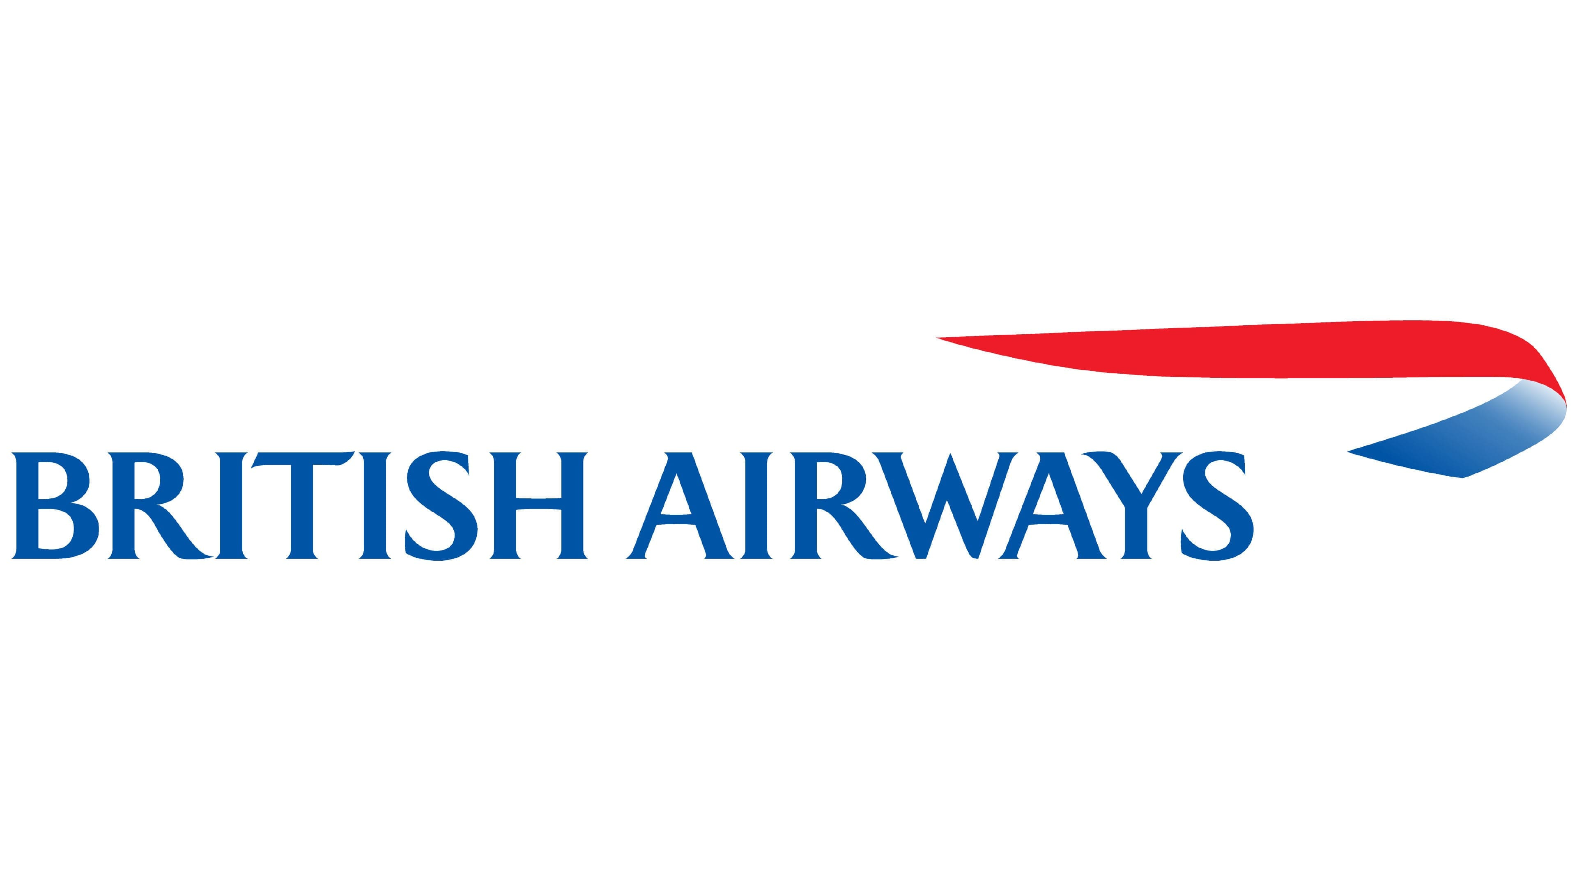
Customer Review Analysis
Company insights through web scraping
17th august 2024

Slide 2
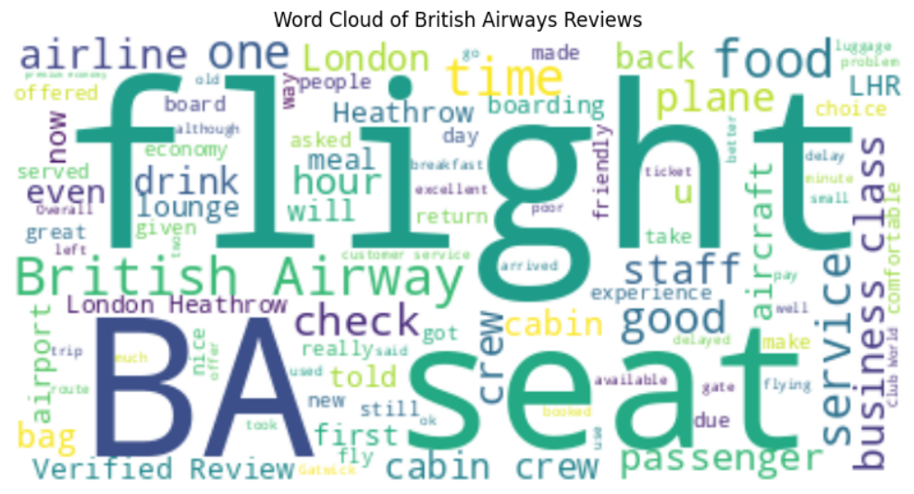
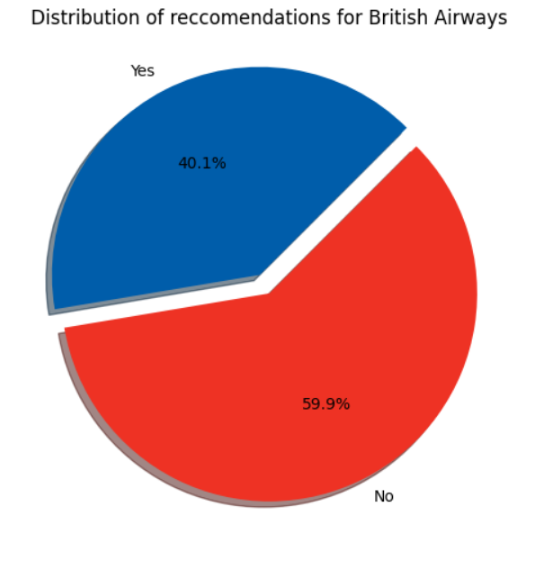
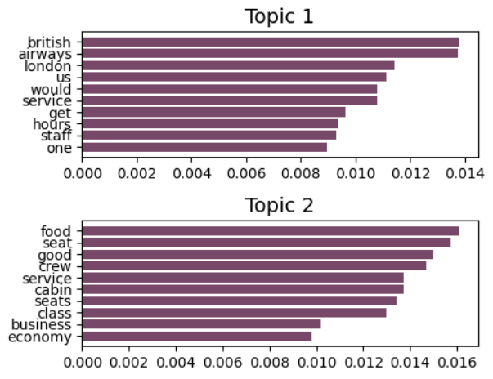
Website scraped – Air line quality
Total reviews cleaned and processed – 3841
Positive recommendation – 1542
Negative recommendation – 2299
Word cloud of
keywords
used in reviews
Most used words determined using topic modelling.
Some of the most discussed topics are food, seat, crew.
Based on recommendations and keywords we can determine that we must work on food, crew and the services for the economy class.

